Slide 1
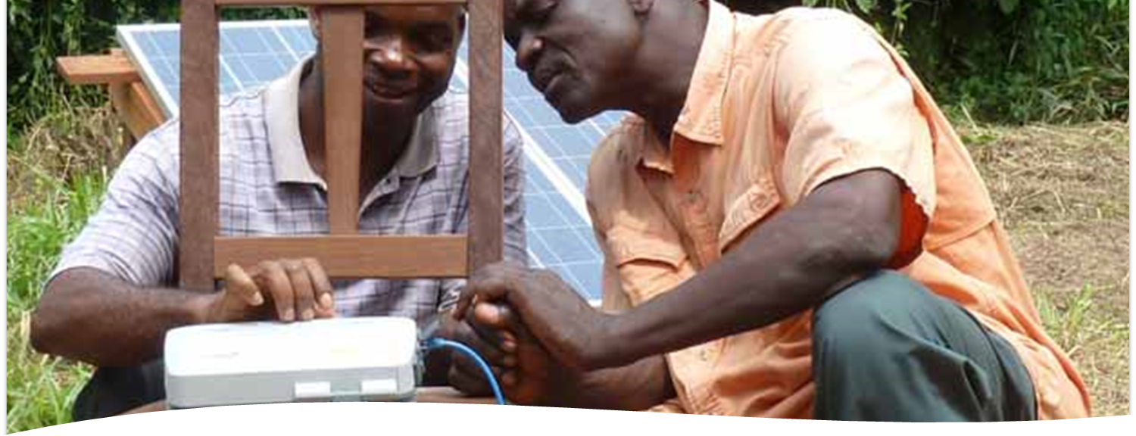
Then those who feared Yahweh spoke with one another. Yahweh paid attention and listened, and a book of remembrance was written before him about those who feared Yahweh and honored his name (Mal. 3:16).
How then can they call on him in whom they have not believed? How can they believe in him of whom they have not heard? How can they hear without a preacher? Then how can they preach, unless they are sent?—As it is written… (Rom. 10:14-15a).
All Scripture is taken from the English Unlocked Literal Bible (ULB), ©2017, 2022 Wycliffe Associates, Available at https://bibleineverylanguage.org/translations, licensed under the Creative Commons Attribution-ShareAlike 4.0 International License.
The English ULB is based on the unfoldingWord® Literal Text, CC BY-SA 4.0. The original work of the unfoldingWord® Literal Text is available at https://unfoldingword.bible/ult/.
Before Translating
Choosing Format and Software

Slide 2
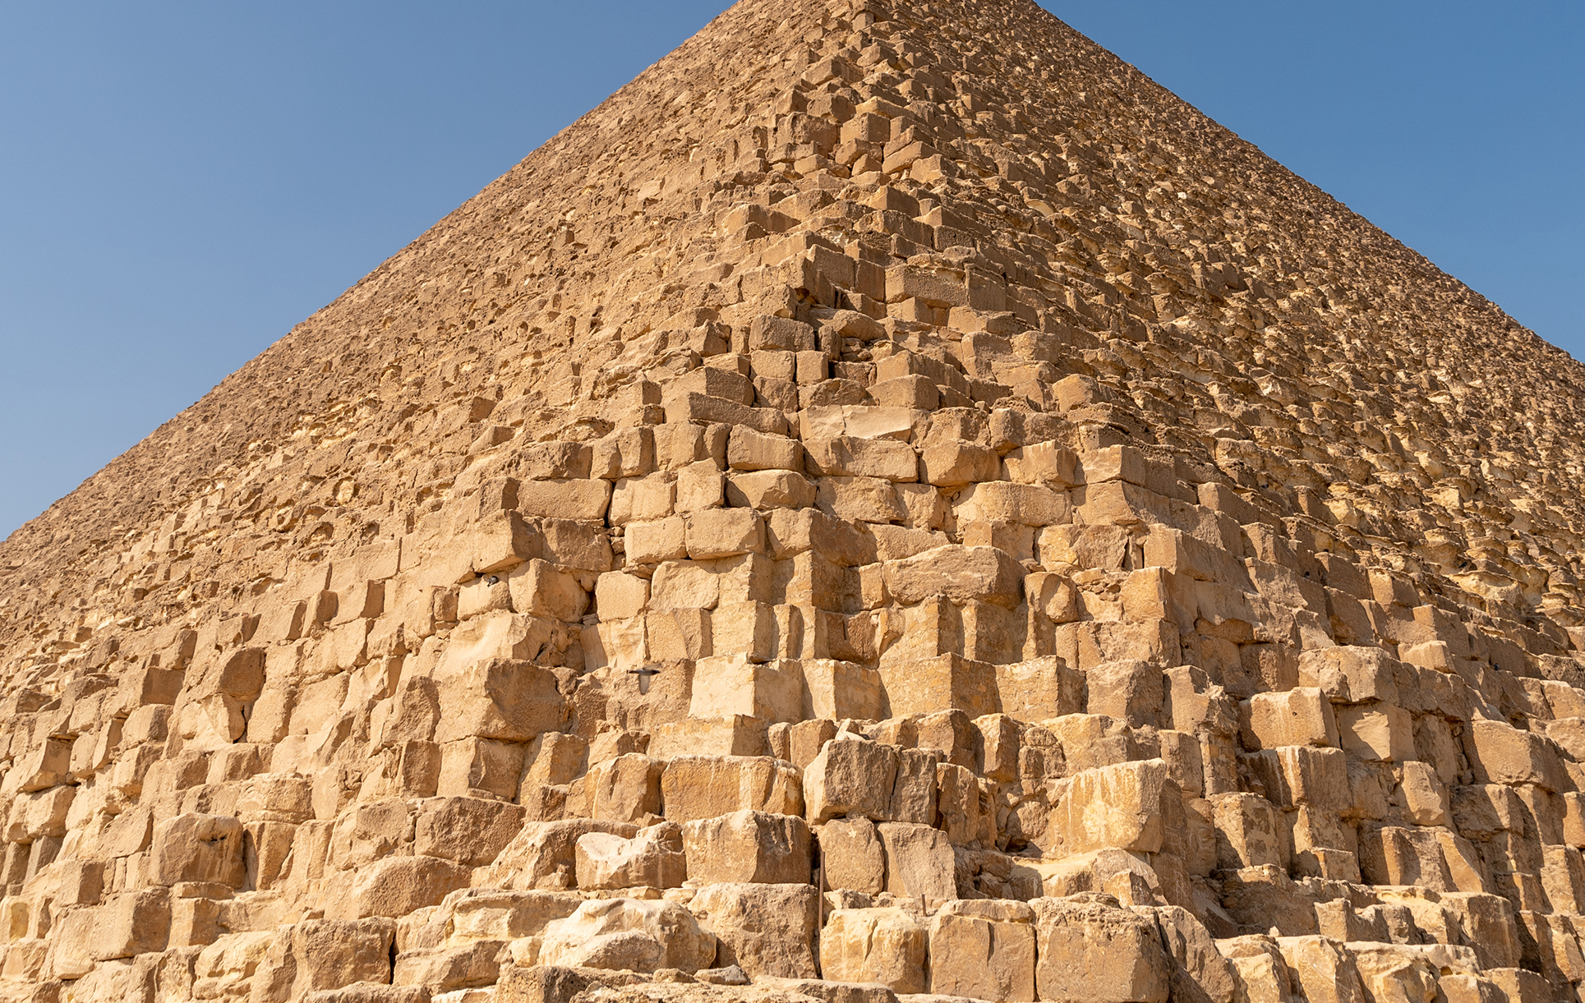
Genesis 11:1–9
Genesis 11:1–9

Slide 3

Over 3000 language groups
do not use
a complete written form
Over half the languages
with no
Scripture
Completely
Oral
Completely
Written

Slide 4
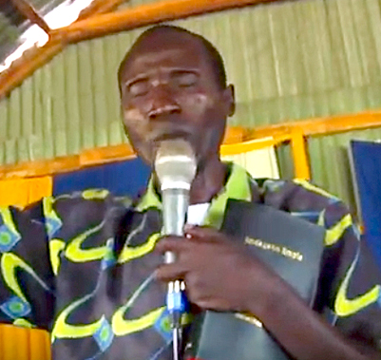
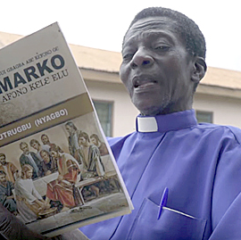
Differences in Oral Communities
Some Oral Communities
Other Oral Communities
Use and respect oral communication
Prefer to communicate important information orally
Value oral communication
Use oral and written communication
Prefer important information to be written
Value written communication

Slide 5
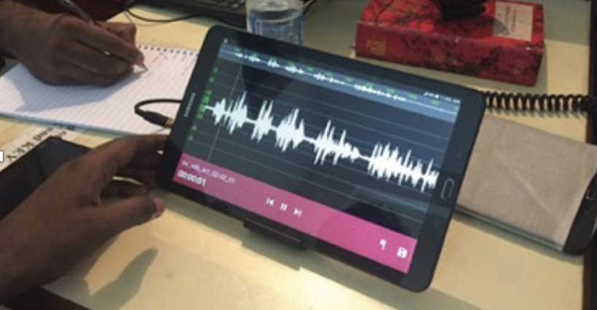
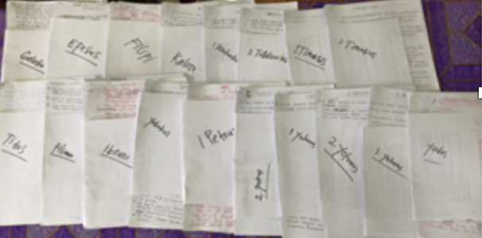
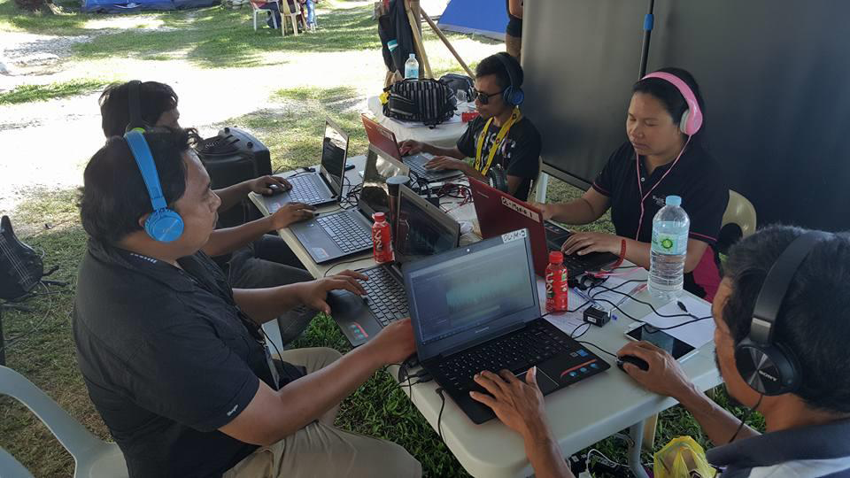
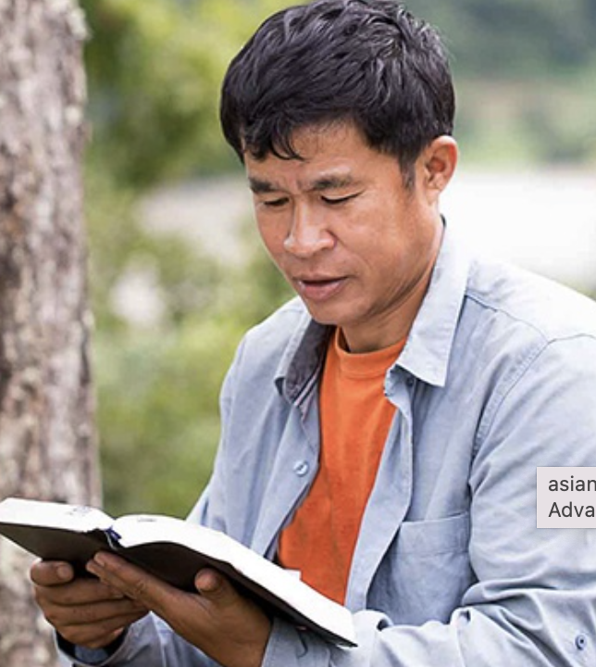
Written Translation
Oral Translation

Slide 6
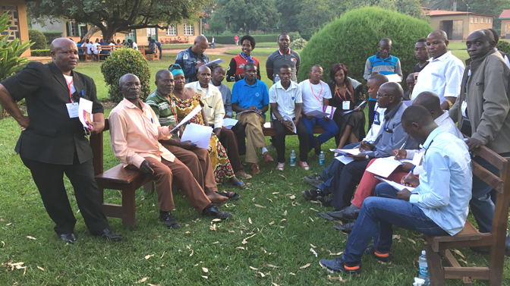

Who Decides?
Local Church
The believers in the community who are invested in getting Scripture for their heart language.

Slide 7
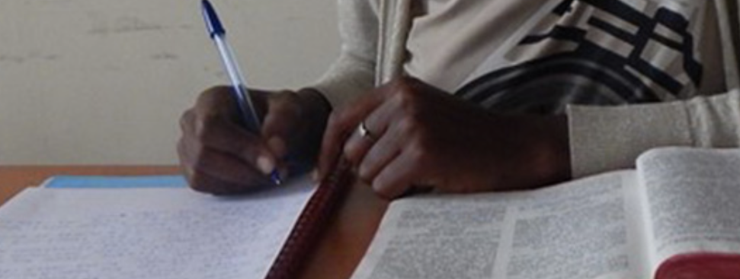
What Should the Church Consider?
Written Translation
Has there been a written language for a long time?
Does the language group have other literature?
Do the people read and write in their heart language?
Is that common?
Is the number of readers growing?

Slide 8
What Should the Church Consider?
Oral Translation
How could people listen to an oral translation?
What do they prefer?
Is literacy wanted?
Are translators able to read the source language?

Slide 9
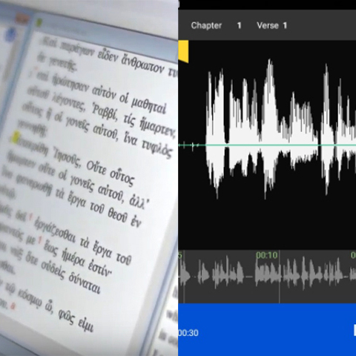
What Are Options for Translation?
If there is a writing system
Translate in writing
OR
Translate in writing and record an audio for non-readers
If there is no commonly used writing system
Translate by speaking and produce an oral translation

Slide 10

Free
Software
Free
Resources
Free
Storage
and Use
on WACS

Slide 11
bibleineverylanguage.org

Slide 12


Translation Formats
writing system?
mp3 or smart phone?
?
Written
Oral
Local Church

Slide 13

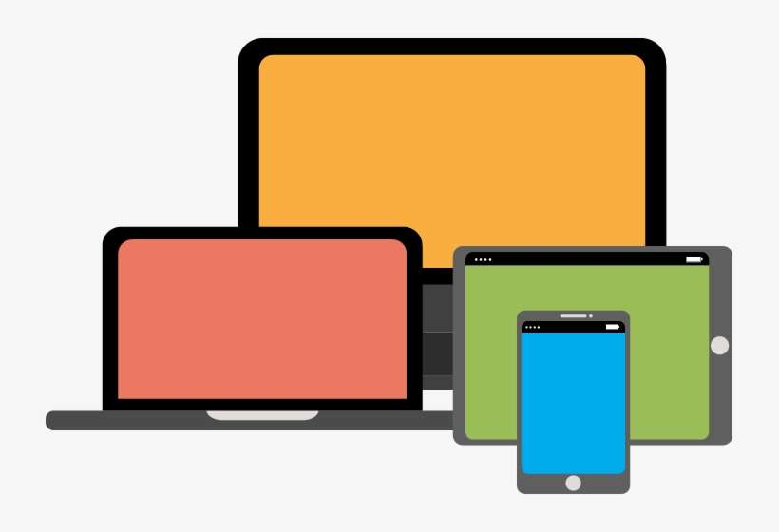




Downloadable
1
2
Checking Resources Included!

Slide 14



Downloadable
Checking Resources Not Included

Slide 15

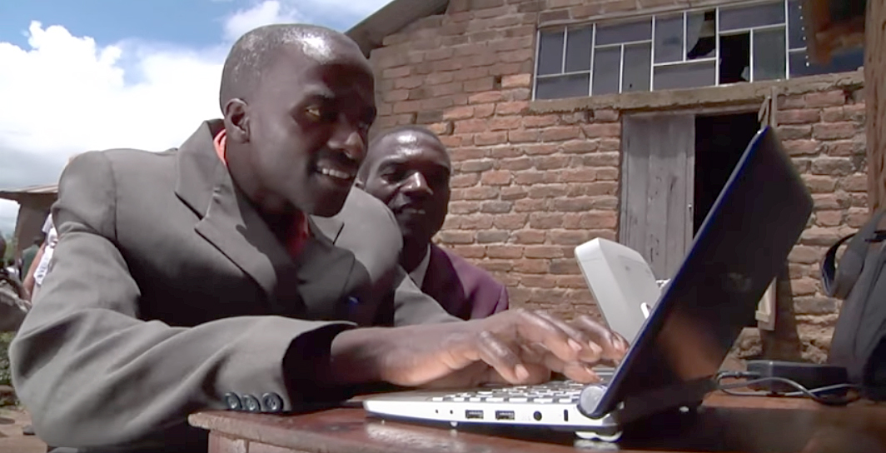
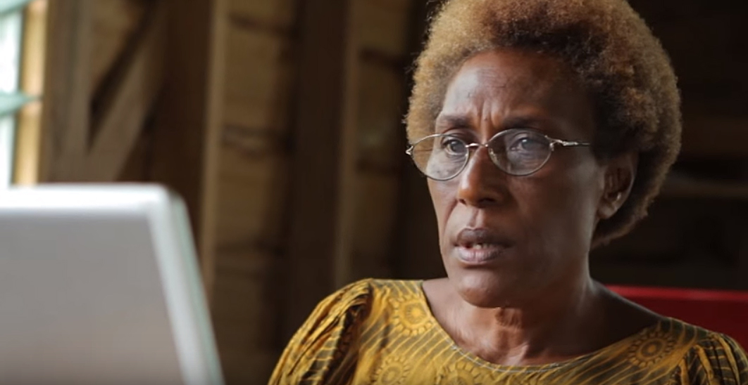
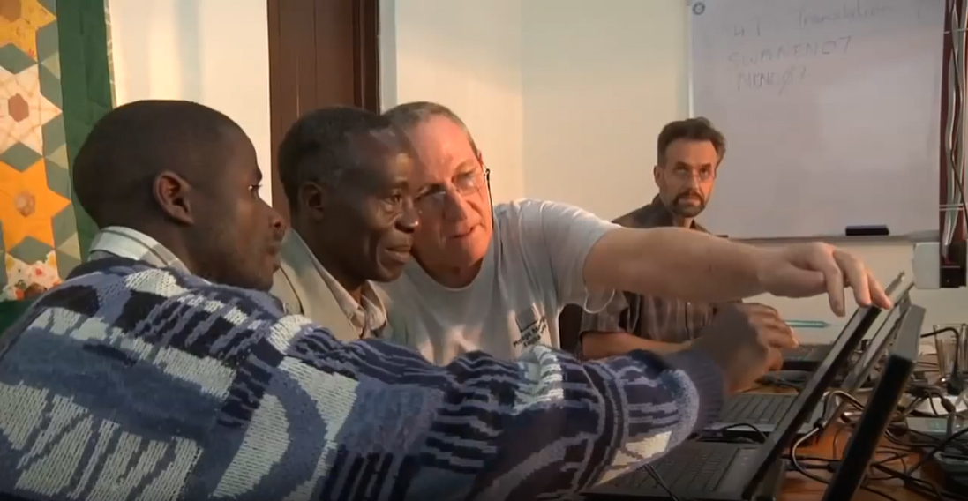
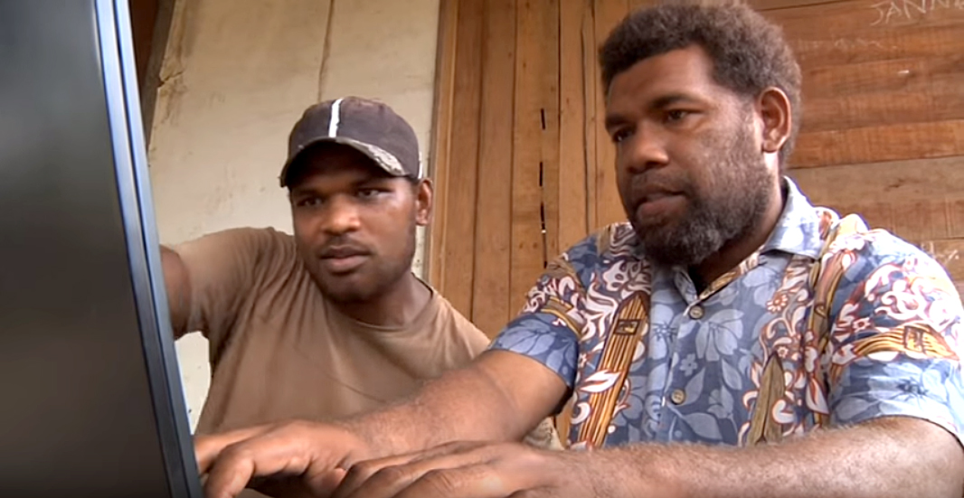
V-MAST Online Network
Checking Resources Available Online!

Slide 16
Free Technical Tools for Written Translations
Downloadable
Only one computer needed
Checking resources included
Downloadable
Simplest one to use
No checking resources included
All translators must work online
COBT 8 Steps built in
Checking resources included

Slide 17
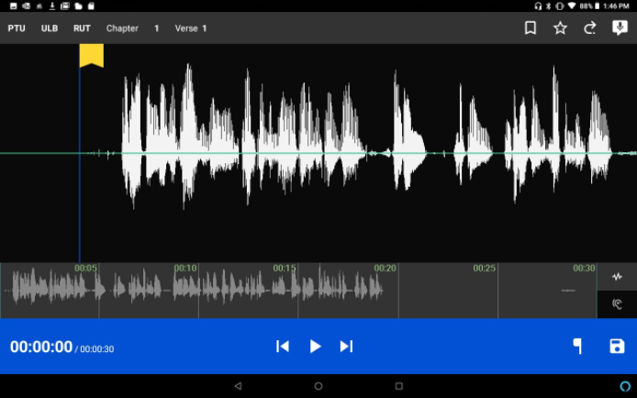
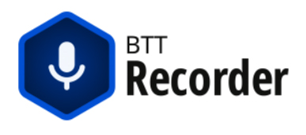

Slide 18

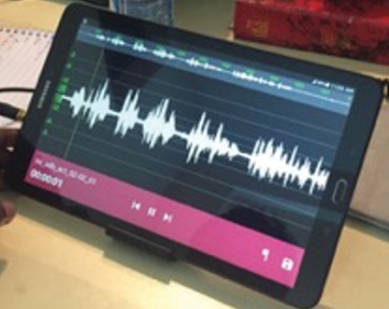
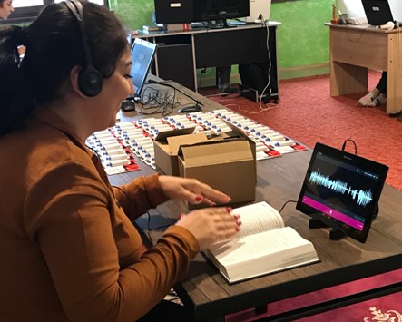
Orature

Slide 19
Free Technical Tools for Oral Translations
Simplest to use
Users must download audio source files
Can also be used for recording written translations
Audio source files are built in
Orature

Slide 20
Orature

Slide 21
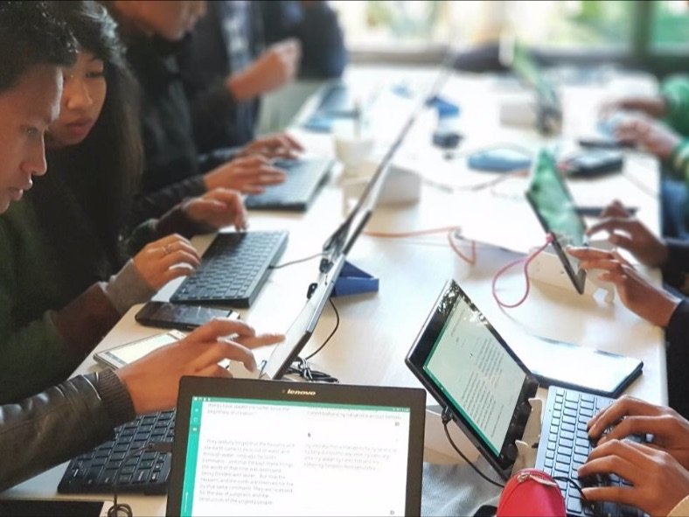
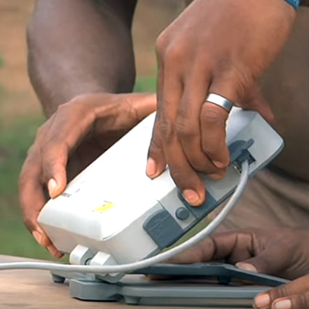
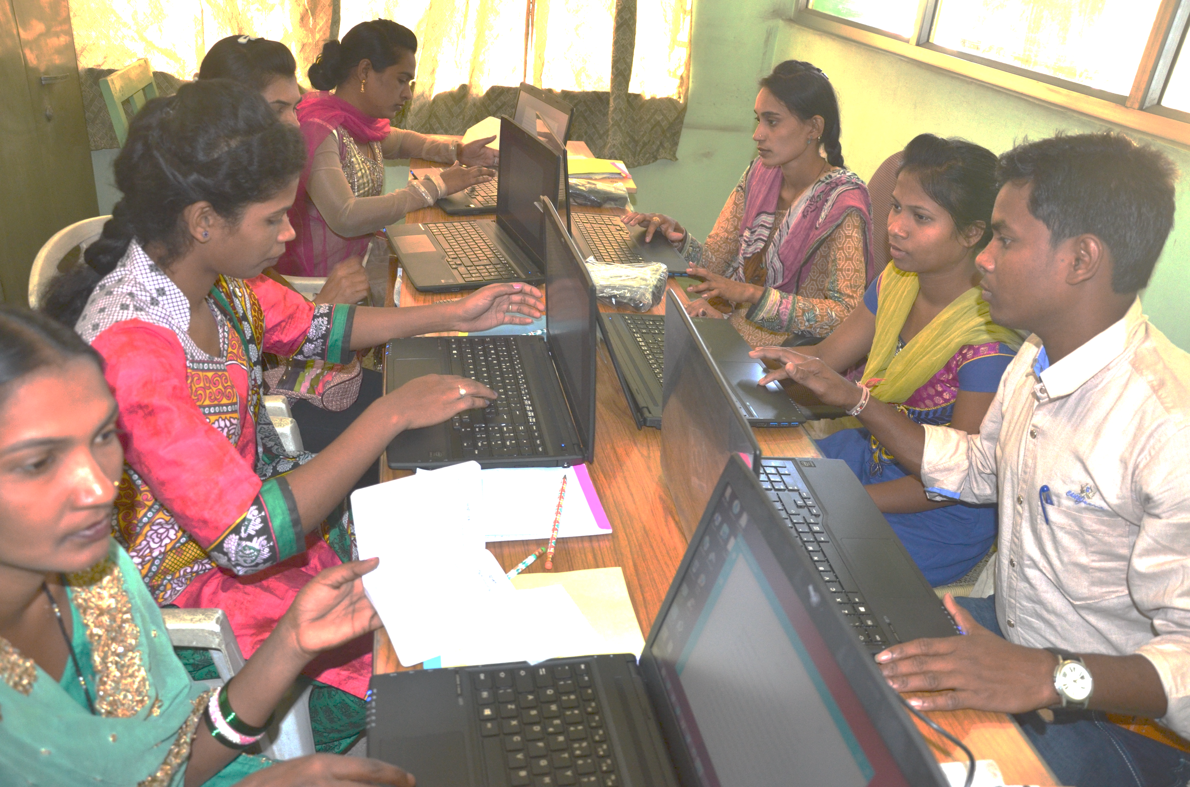
?
Consider:
Accessibility to laptops
Which tool works best?
Accessibility to good internet
Computer literacy of translators

Slide 22

?
Benefits?
Challenges?
Local Church

Slide 23
Psalm 102:18
This will be written for future generations,
and a people not yet created will praise Yah.

